Slide 1
“Rêver À Contre-Courant”
(Dreaming against the Current)
Léonard Wantchékon
Autobiographie
February 17, 2022

Slide 2
Summary
The odyssey of a young child from a peasant family in Central Benin who excelled in math, became a pro-democracy activist, and later a professor of political economy at Princeton.
Along the way, was expelled from college, spent five years in hiding (1979-1984) and 18 months in prison (1985-1986). Escaped in 1986, and since then, has lived in Nigeria, Ivory Coast, Canada and US.

Slide 3
Part I: Childhood

Slide 4
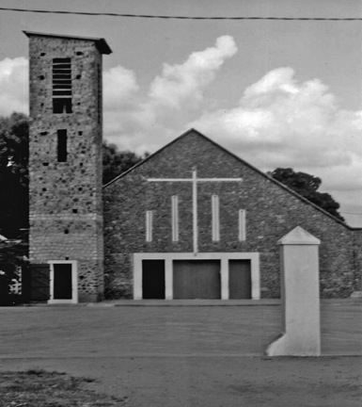
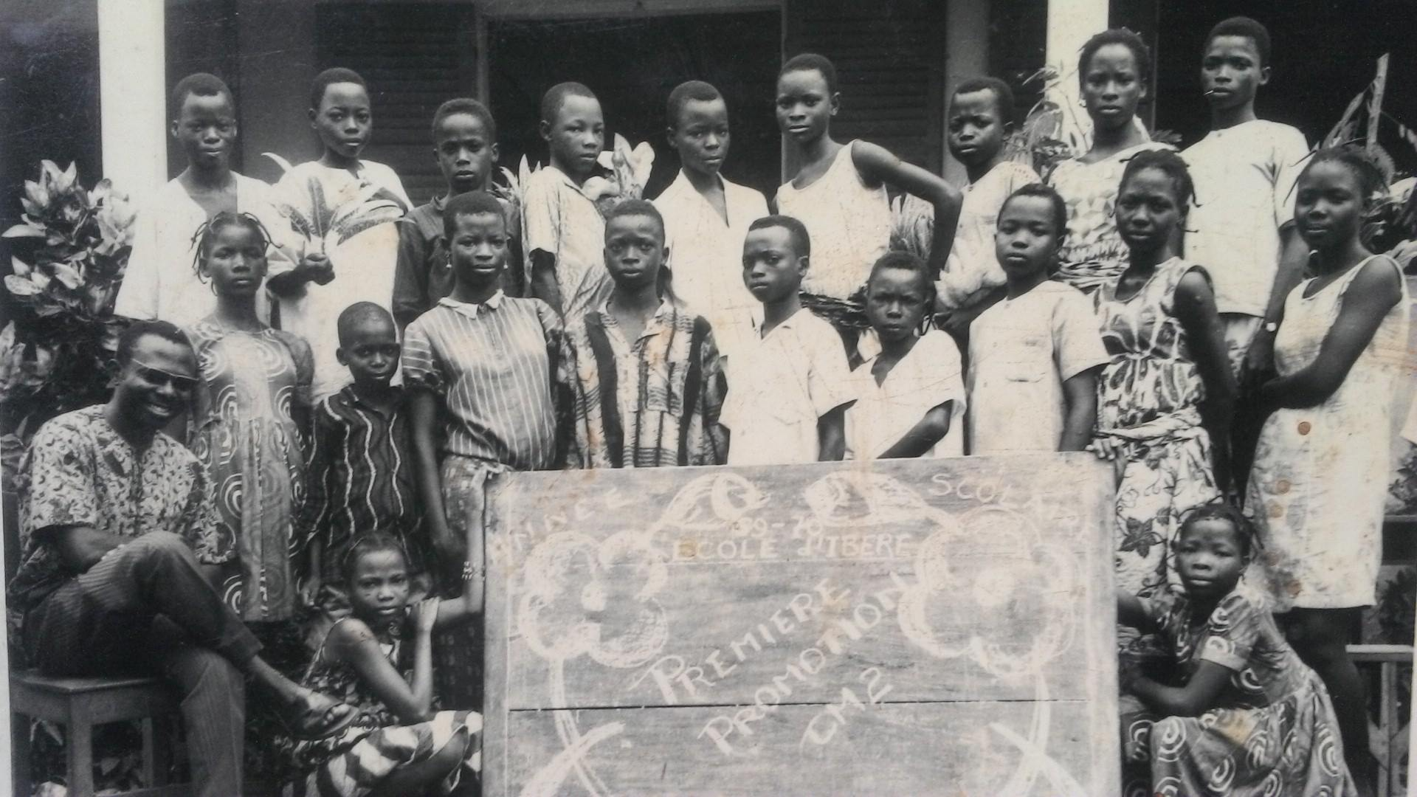
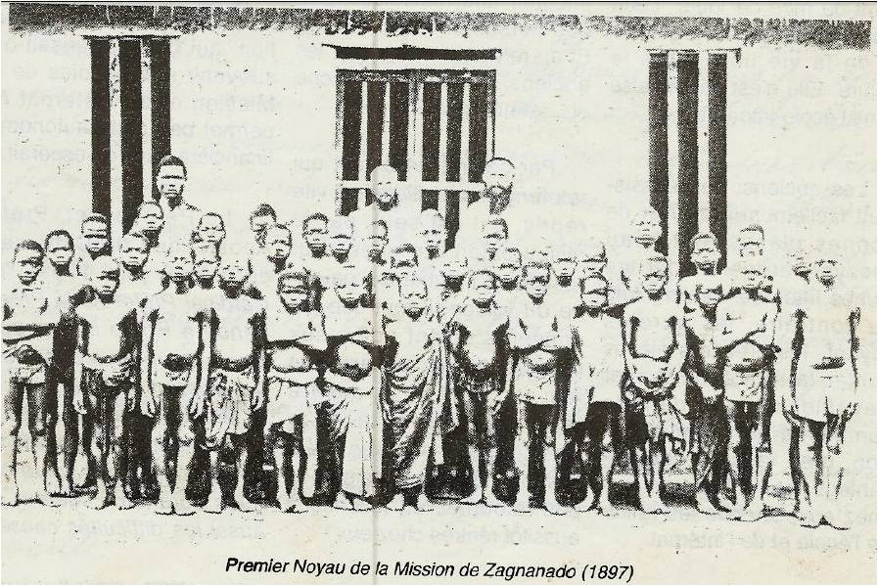
Grew up in Zagnanado, a cosmopolitan town and a former military post of the Kingdom of Dahomey.
Zagnanado Church: Built on a Monarchical Site of Old Dahomey around the 19th century
IBERE Primary School, Sixth Grade
Evidence for Early Exposure to Education: Catholic School in 1897

Slide 5
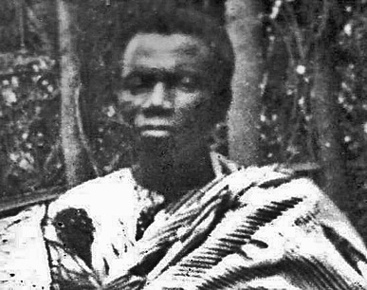
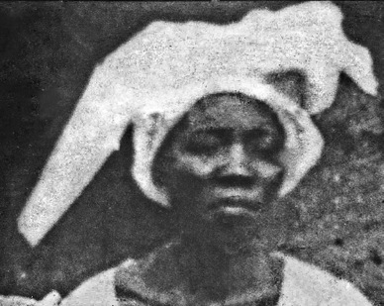
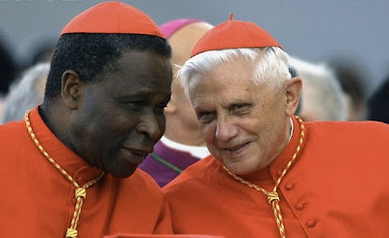
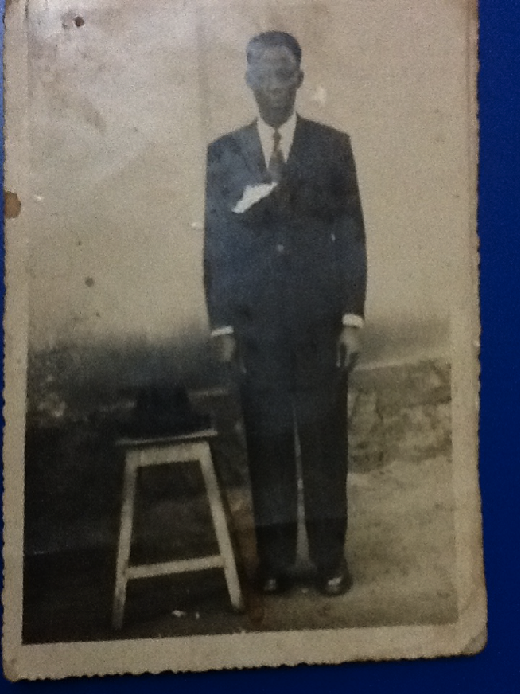
My Father, Innocent Wantchékon (1973)
My Mother, Virginie Boko (1973)
Cardinal Gantin, an Influential Figure from Zagnanado (with future pope Benedict. XVI
My Uncle, Renée Wantchékon

Slide 6
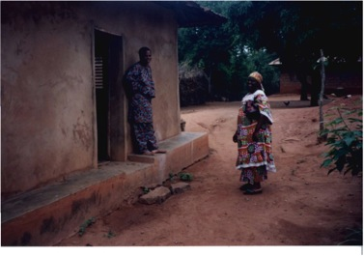
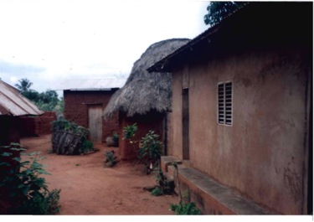
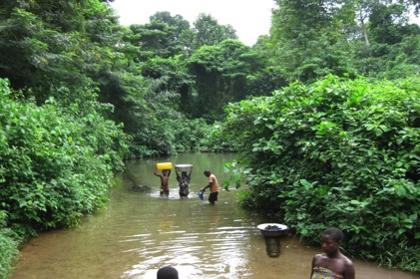
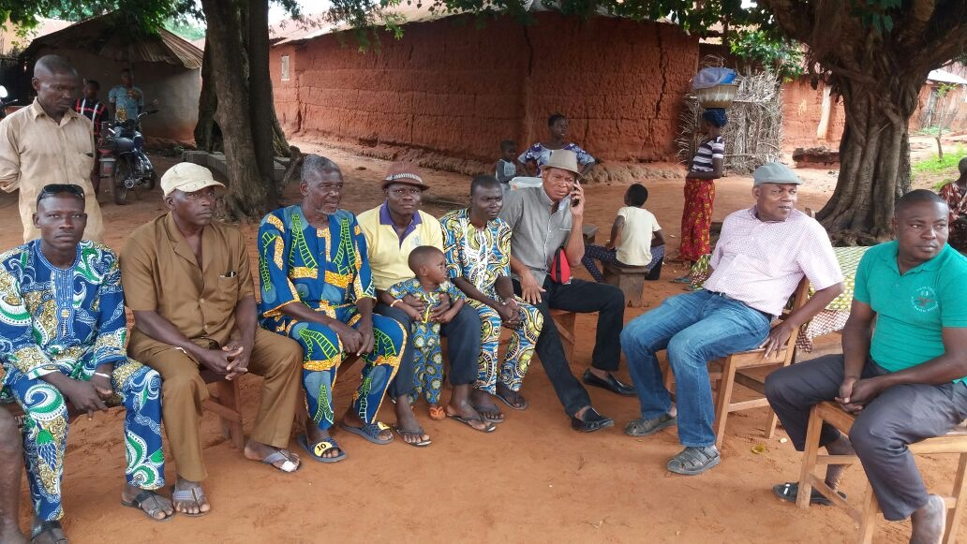
Life in Doga Vedji (Zagnanado)

Slide 7
Part II:
Entry into Political Activism

Slide 8
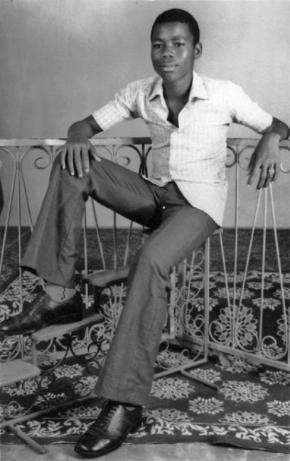
City Boy! (1972)
Moved to Cotonou for middle school and became a political activist (1973) following the assassination of Amílcar Cabral.
Led student takeover of school curriculum and teaching after an extended period of teachers’ absence in the 12th grade (6 months in 1977).

Slide 9
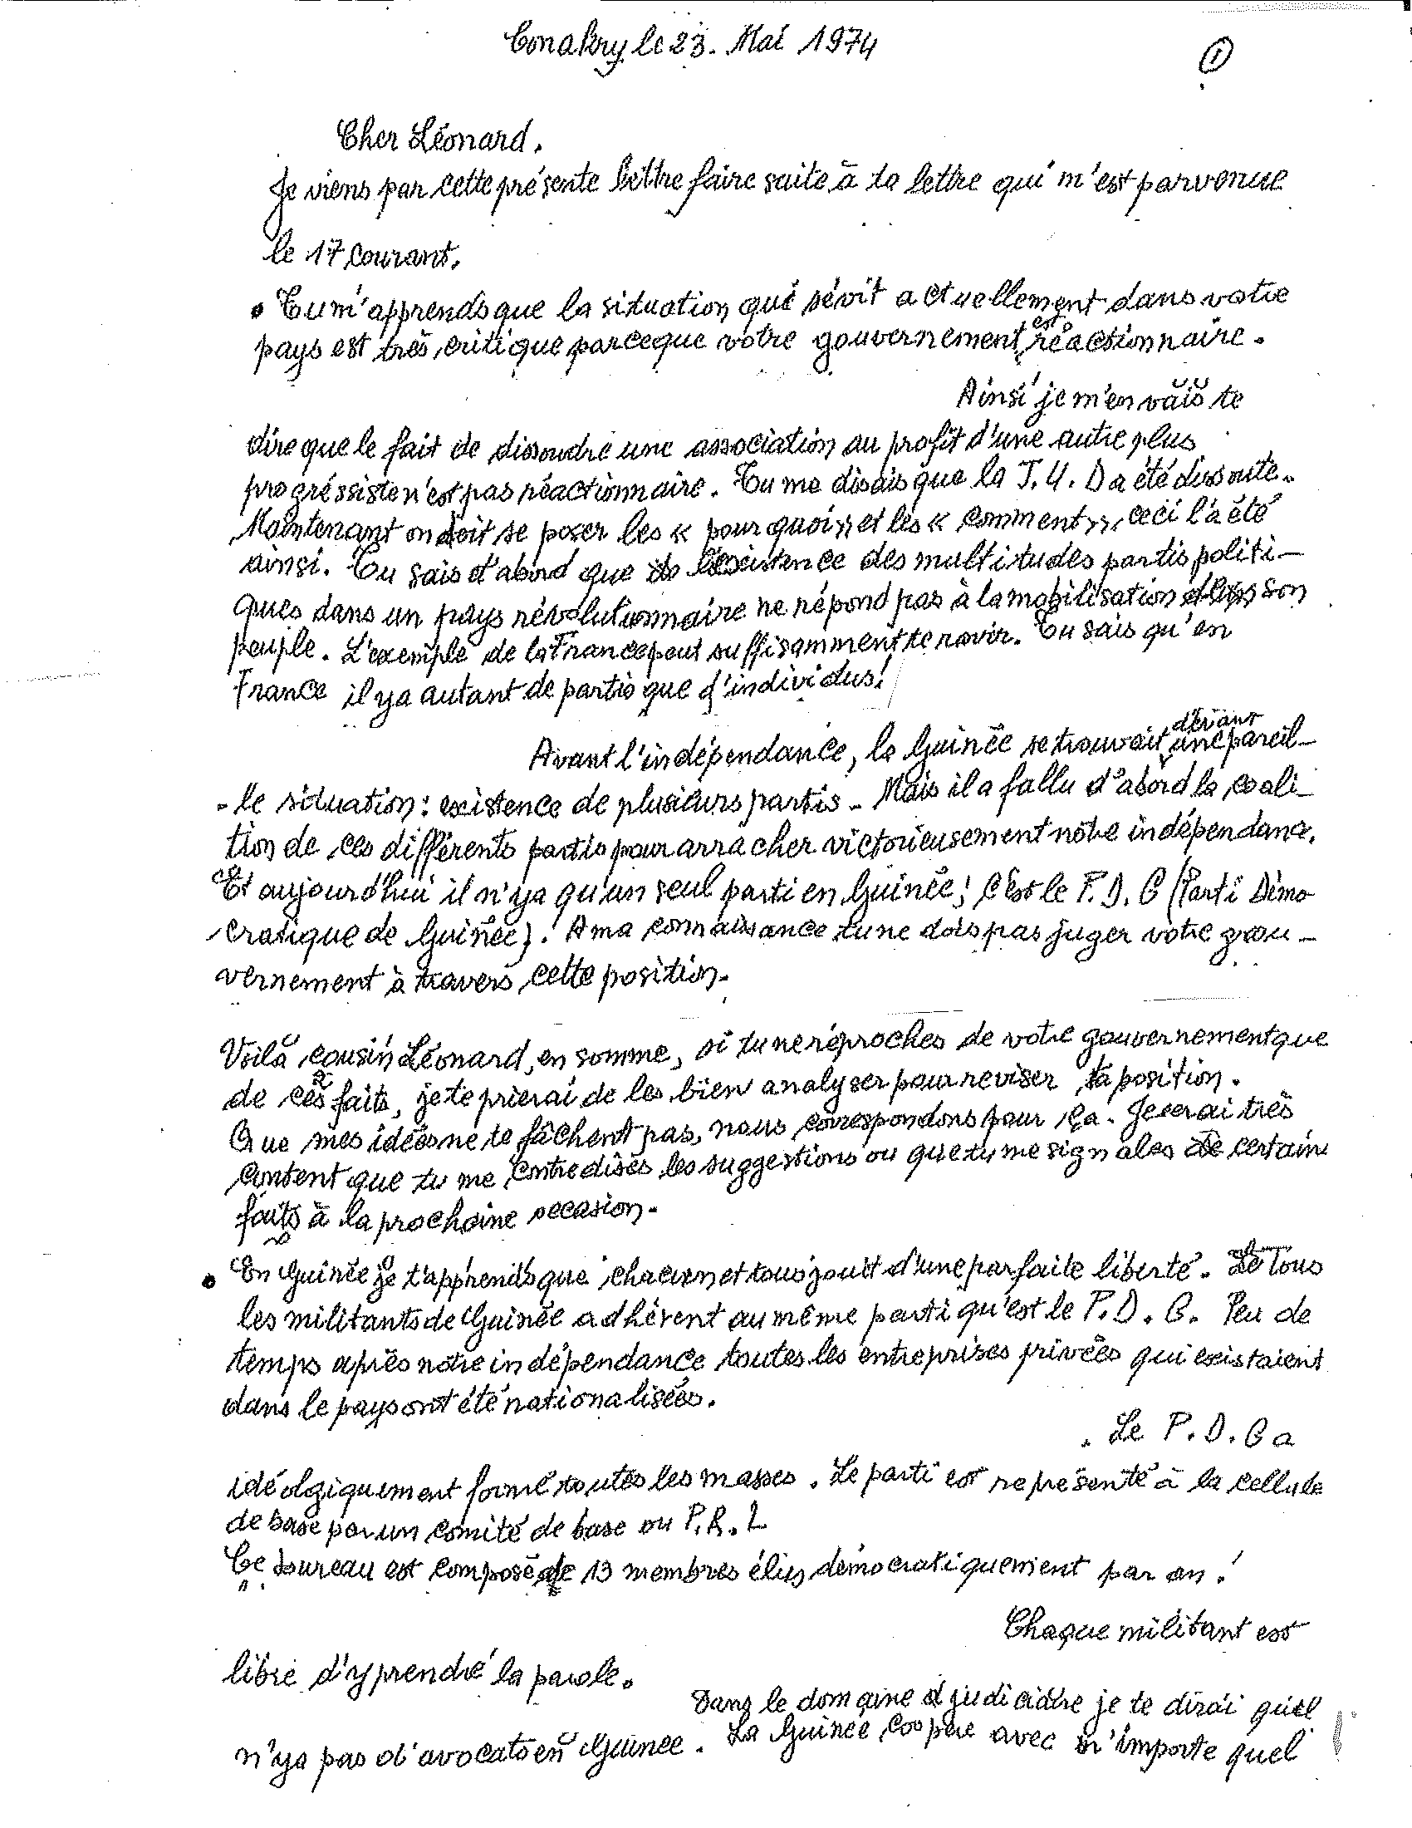
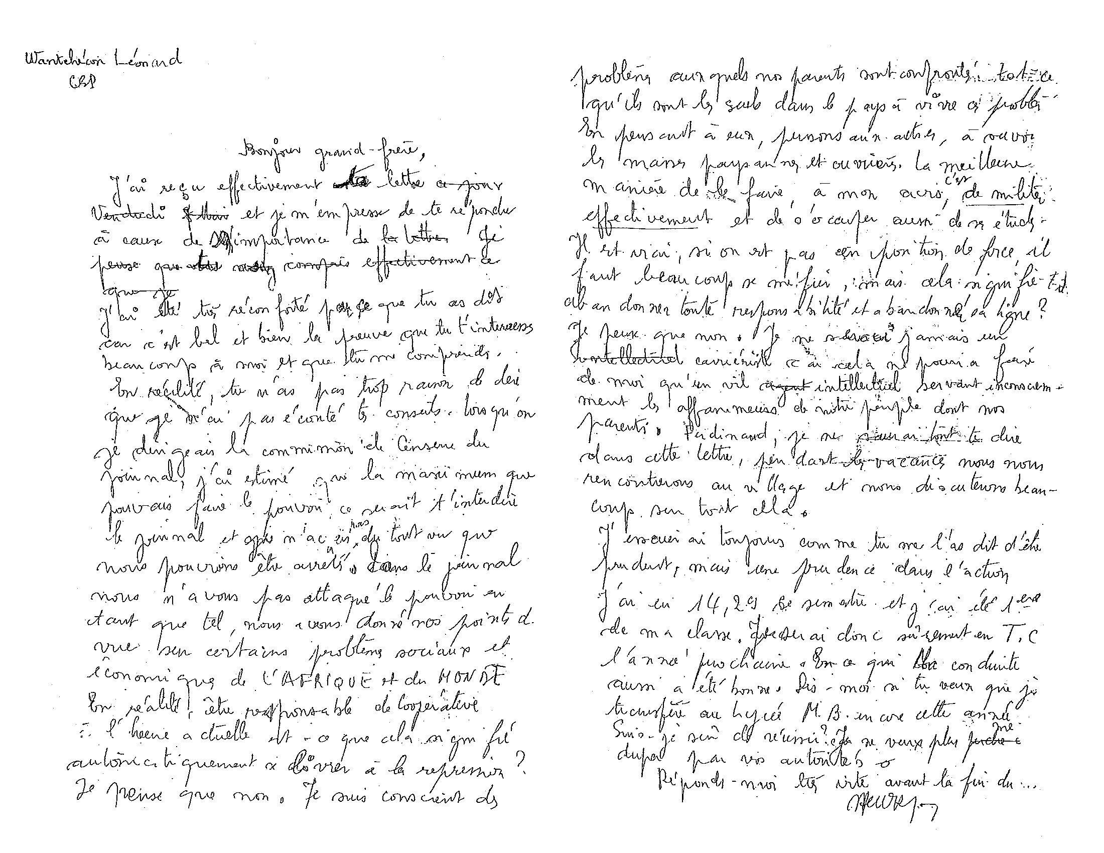
Political Activism Translated to Transnational Correspondence for the Promotion of Democracy
Letter from I.K. Diallo in Conakry, Guinea (1974)
Letter to Ferdinand about Cabral: Je serai Jamais un intellectuel carrieriste (1976 )

Slide 10
Part III:
1985 Student Uprising & Imprisonment

Slide 11
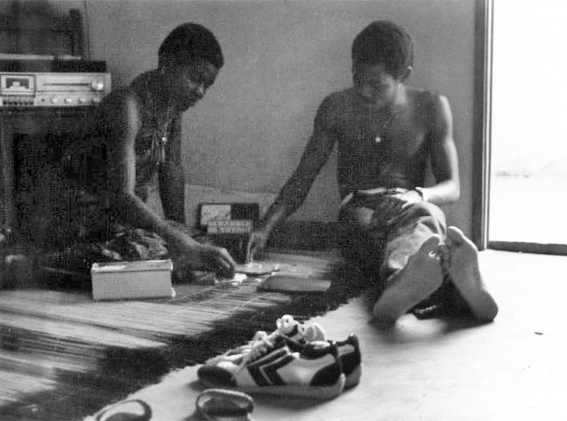
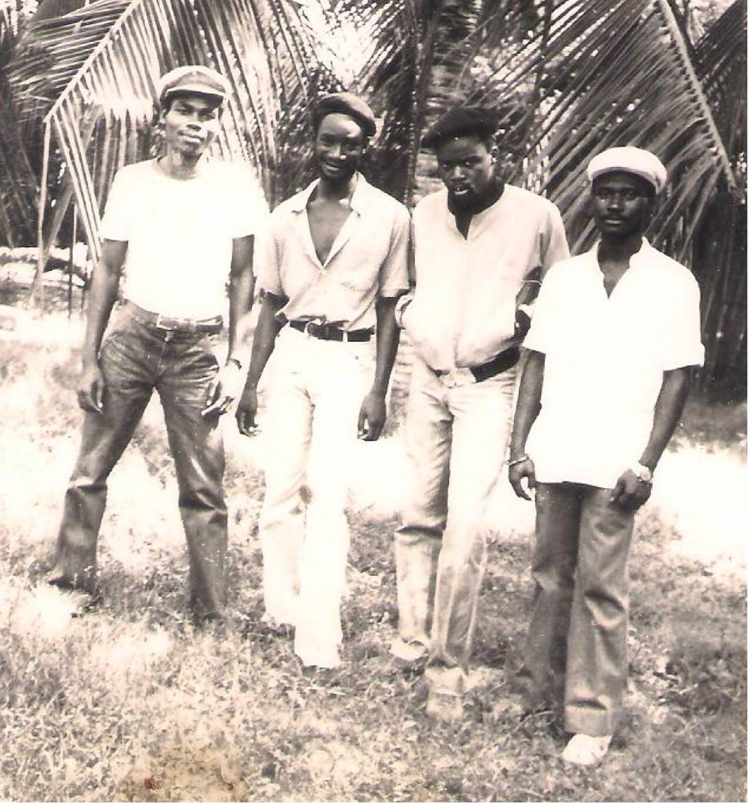
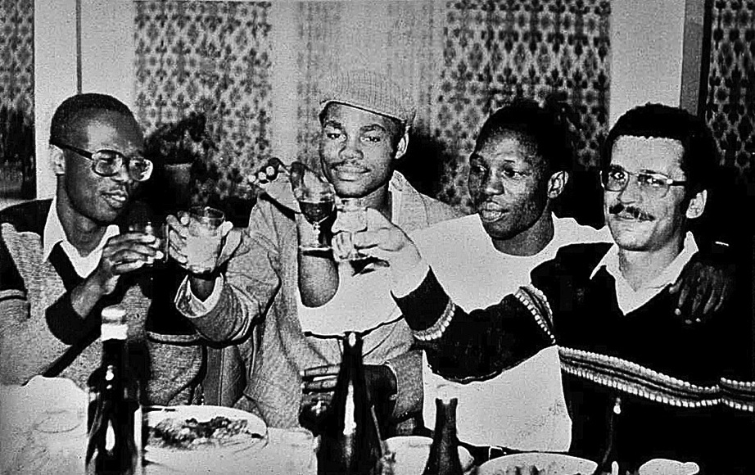
With Catherine, playing scrabble in my hideout at Cotonou (1983)
Co-founder of the Communist Party (PCD) as freshman, led the 1979 student uprising which caused expulsion from university. As a professional revolutionary, spent five years in hiding and was eventually appointed as a member of the shadow opposition government (1982) .
With fellow comrades of the underground student movement
At a conference for young communists at Tirana, Albania (1982) with Togolese, Burkinabe and French comrades

Slide 12
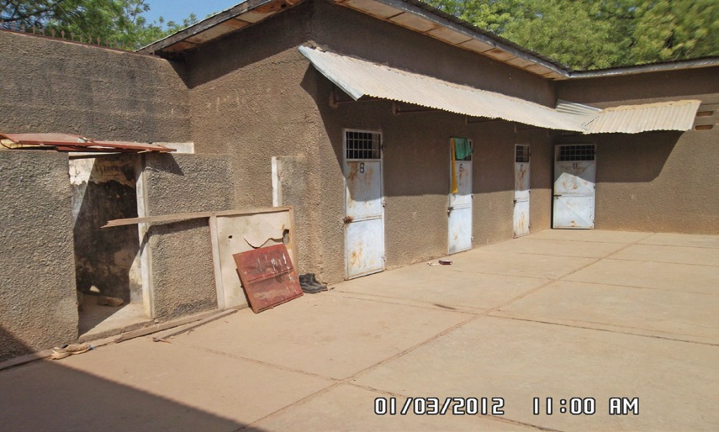
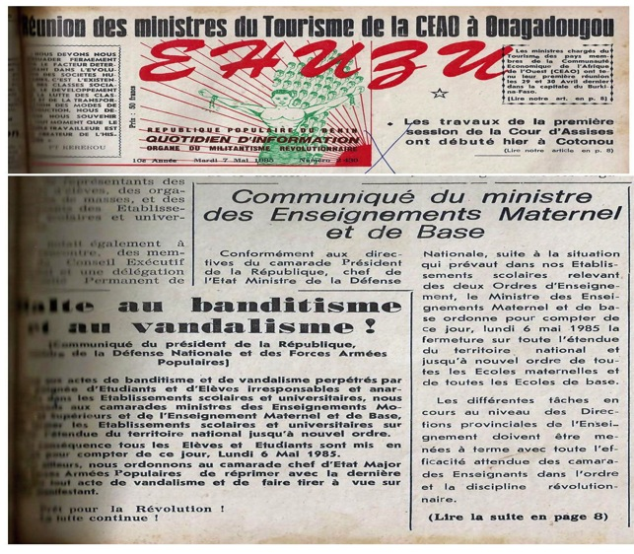
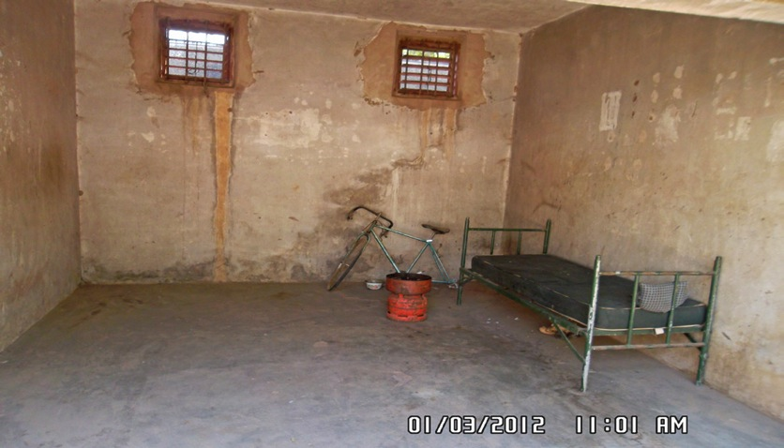
Government Propaganda News: Banditry, Vandalism. (The order was to shoot on site any protester).
Arrested on July 18, 1985, following the May 1985 revolution, and imprisoned and tortured for 19 months at the “White House,” in Cotonou and the Segbana prison.
Ségbana Prison Today: HELL (~107 °F)
Inside of my cell (No 13) in Ségbana (aka Kampuchea): The windows were inserted after my imprisonment.

Slide 13
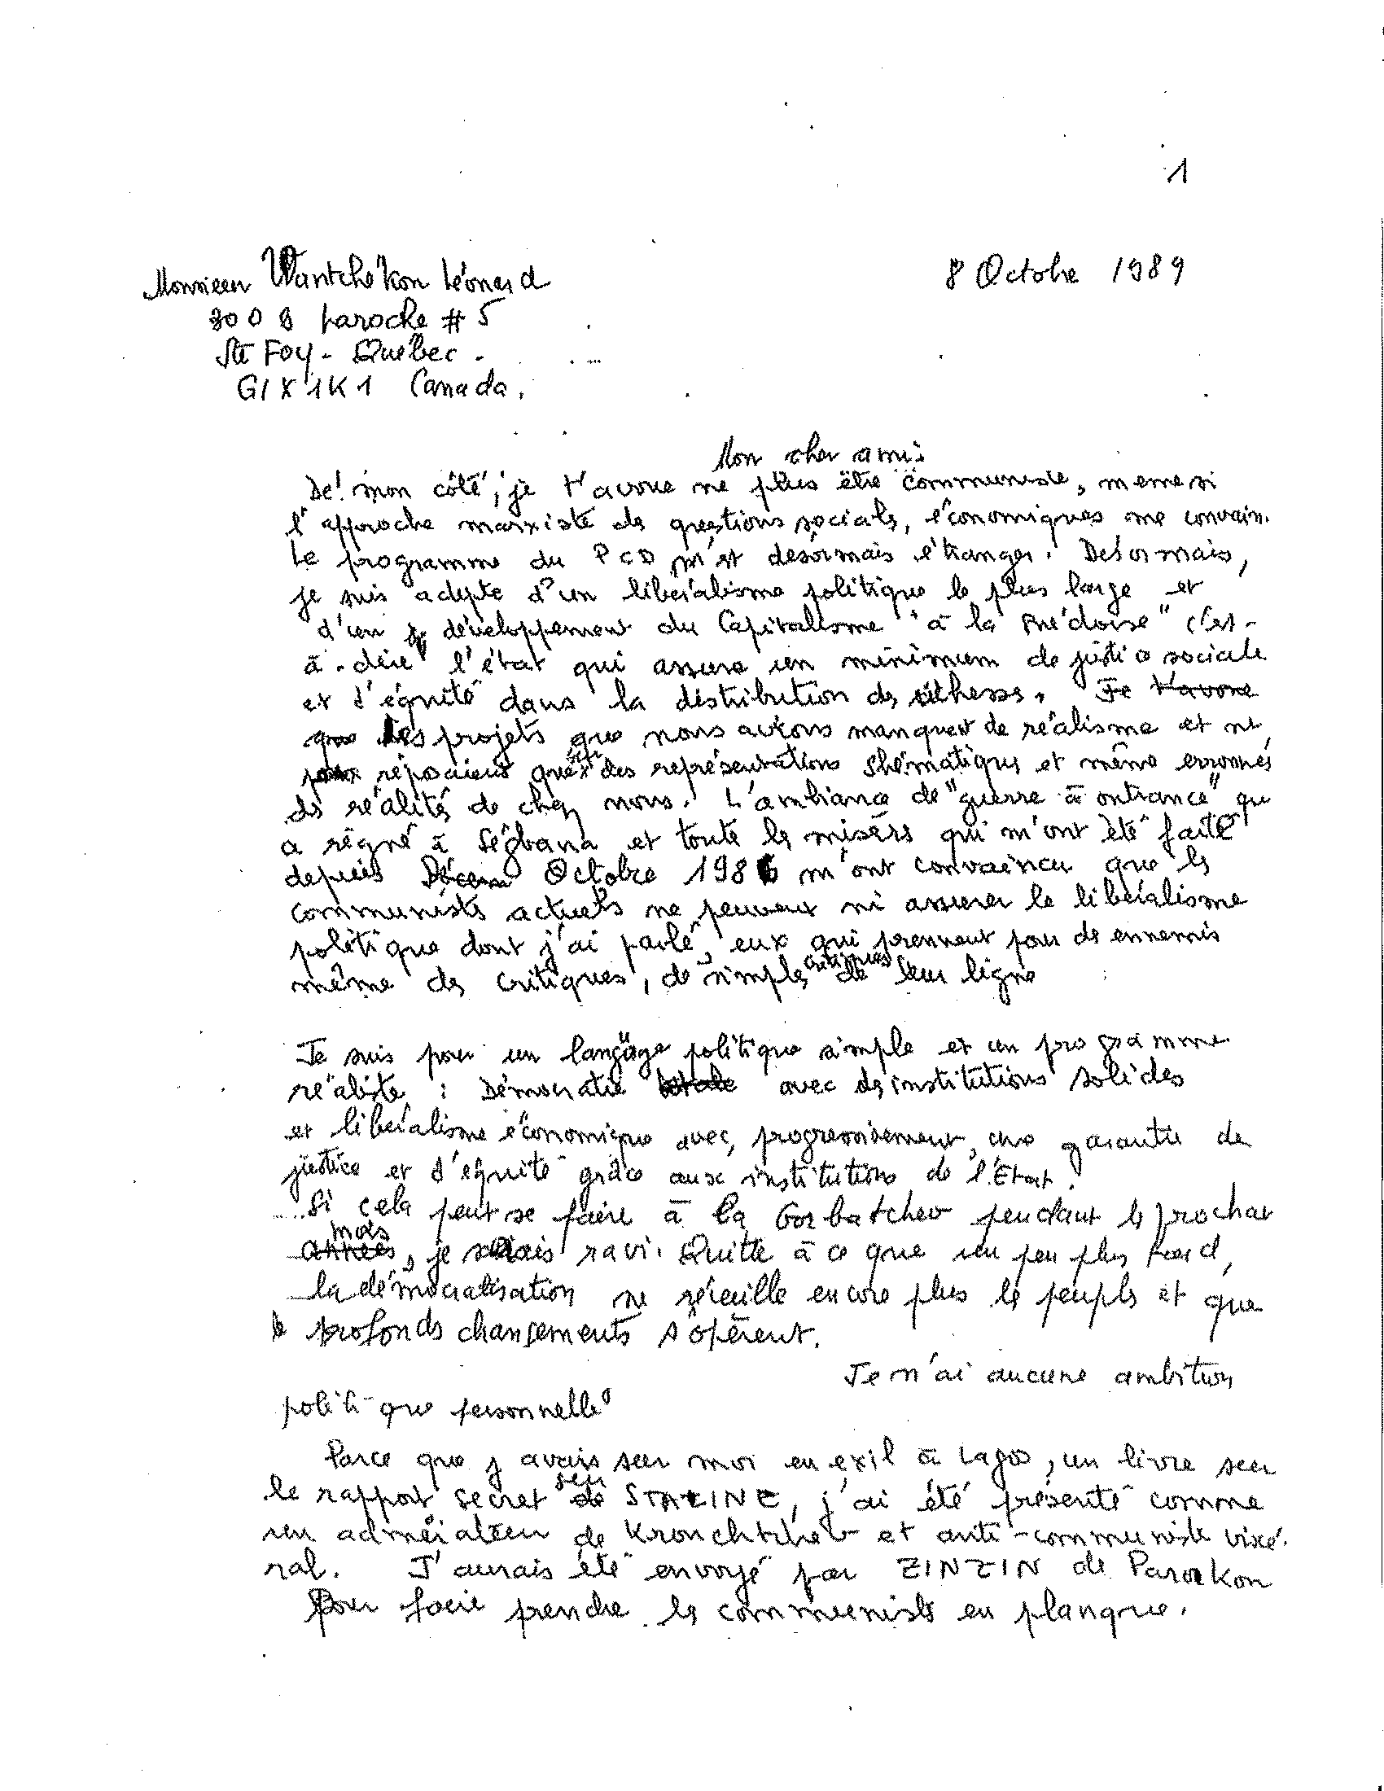
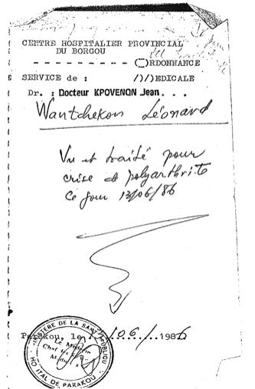
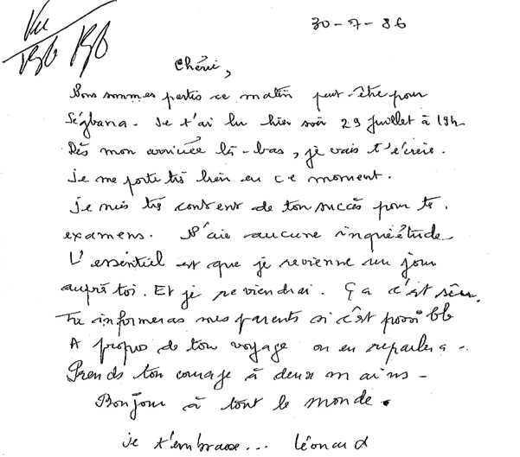
Letter to Catherine (1986) from prison expressing my optimism
Remained optimistic in prison, broke from the communist party after internal conflicts and eventually escaped in 1986.
Letter to a comrade explaining why I had left the communist party
Doctor’s diagnosis of acute arthiritis which enabled my prison escape

Slide 14
Part IV: Exile, Return and Reflection

Slide 15
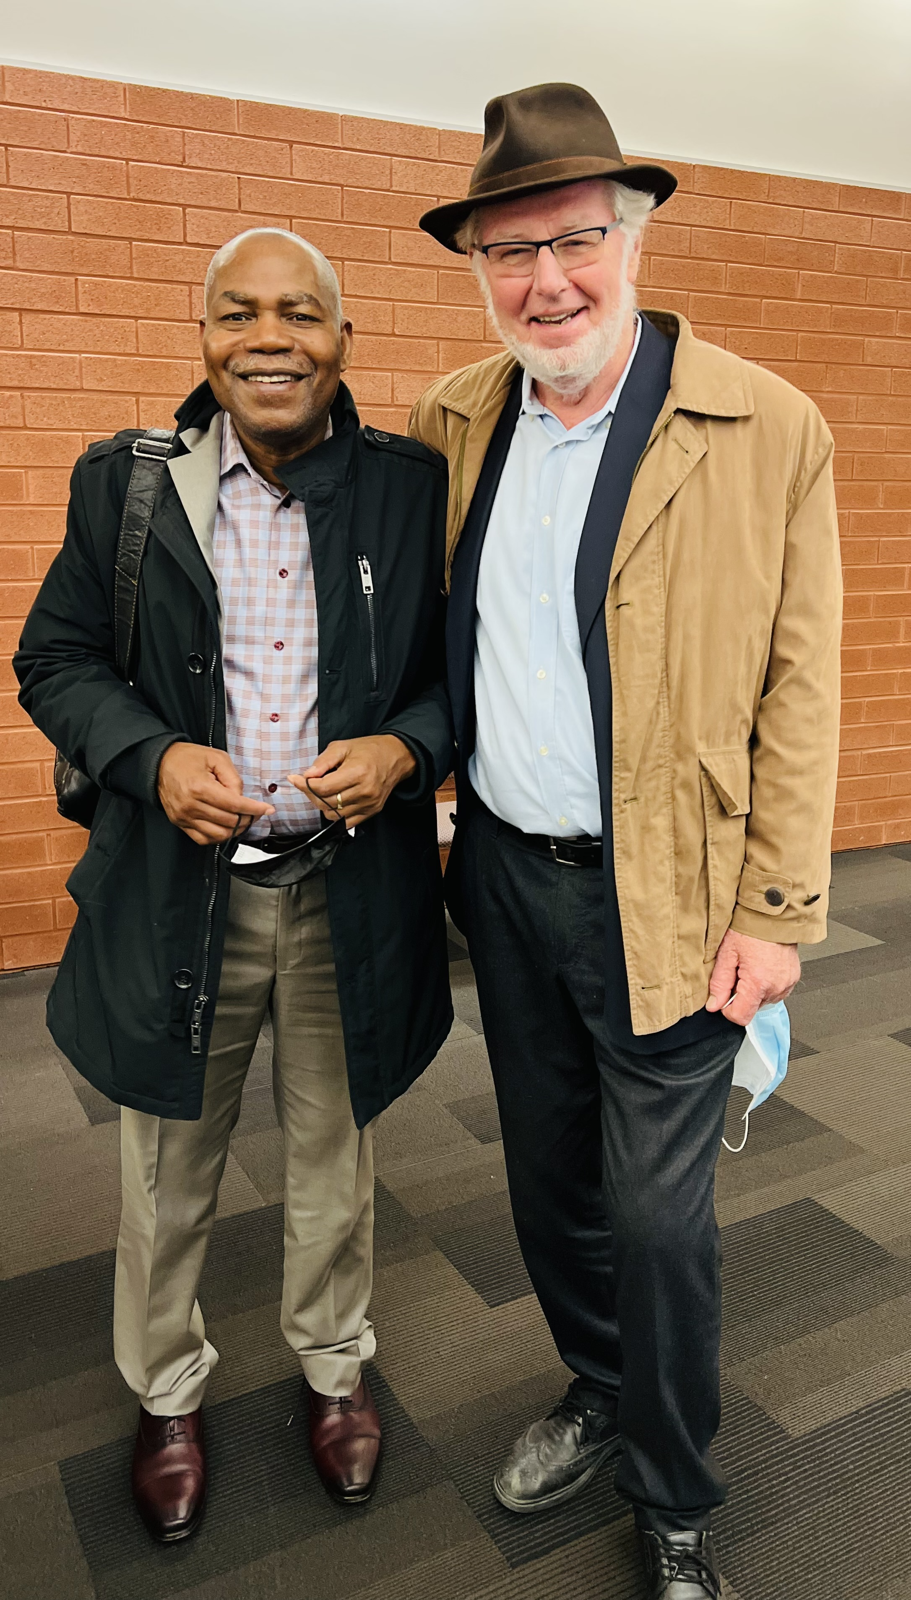
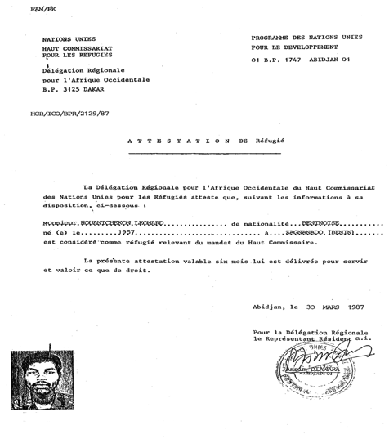
Escaped to Lagos and became a political refugee in Abidjan (1987). Immigrated to Canada and pursued Masters at Laval University.
Political Refugee Certificate in Abidjan (1987)
Recent photograph with Bernard Decaluwé, Professor at Laval who got me admitted in their master’s program with no undergrad degree (1988)

Slide 16
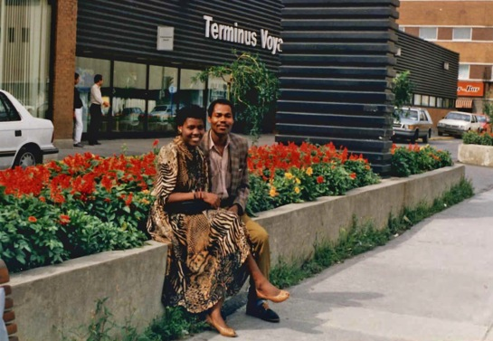
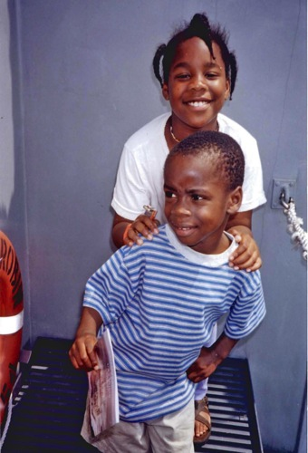
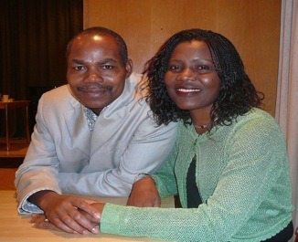
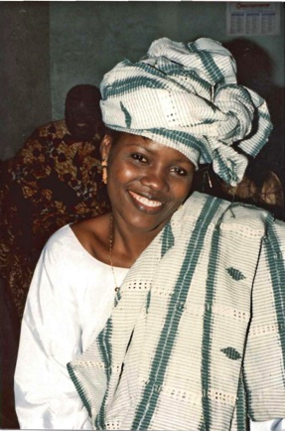
Traditional marriage photo of Catherine
Got married and started a family in North America.
At a Montreal Bus Station before heading to Vancouver for my PhD (1991)
Kristia and Travis in New Haven (Summer 1997)
With Catherine (2009)

Slide 17
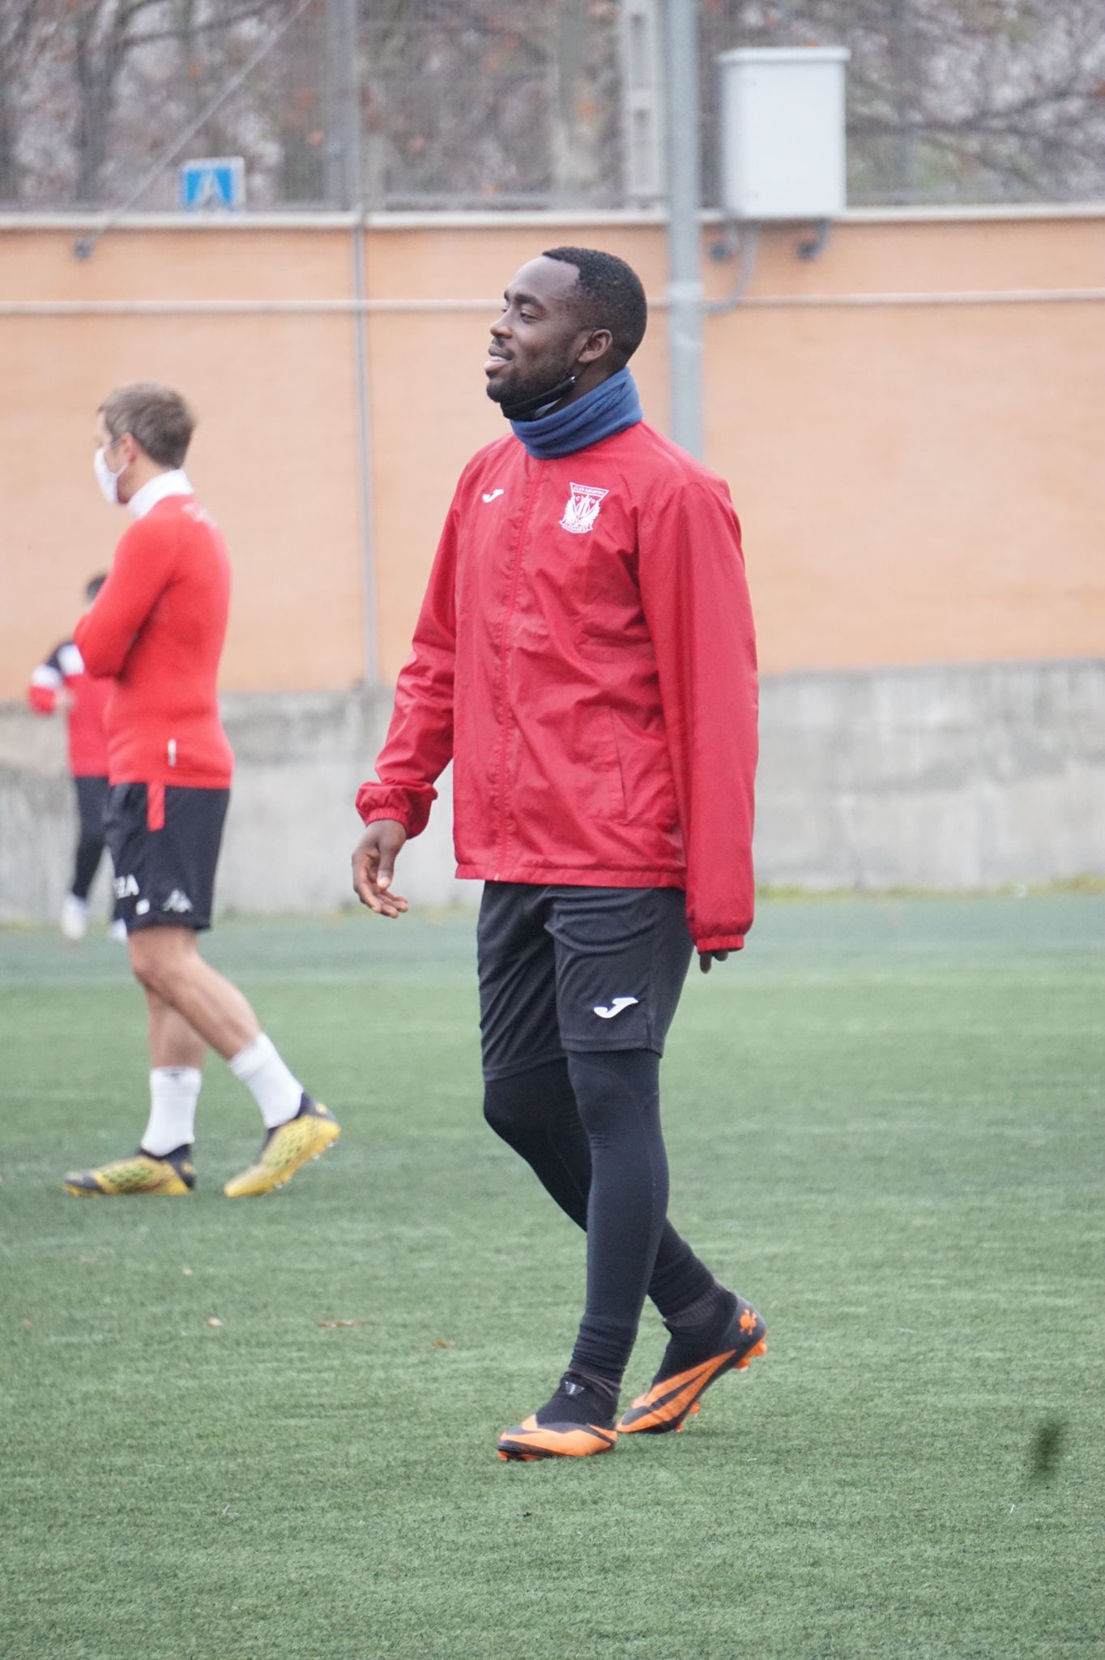
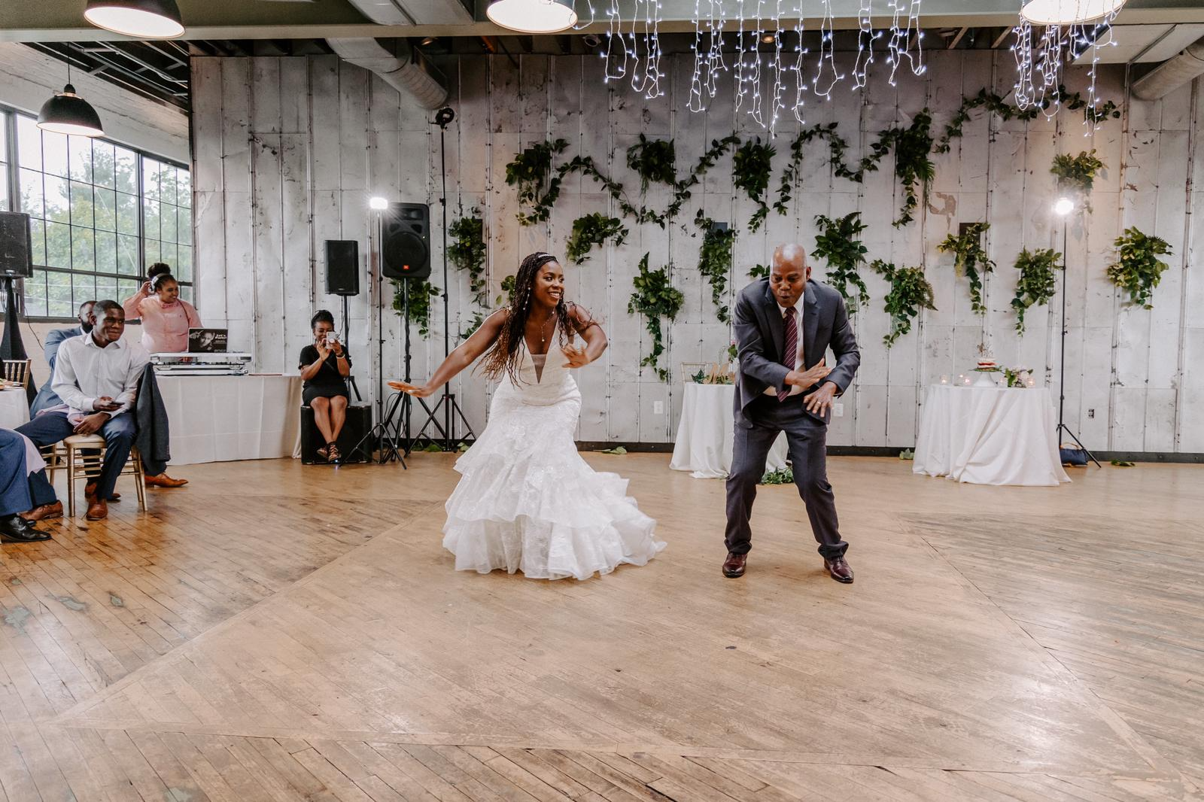
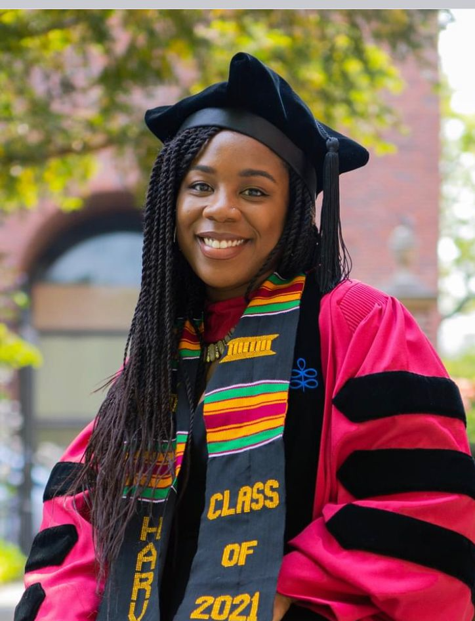
Travis’ Training for Soccer Coaching in Madrid
Father-Daughter Dance at Kristia’s Wedding
Kristia’s PhD. Graduation, Harvard (2021)

Slide 18
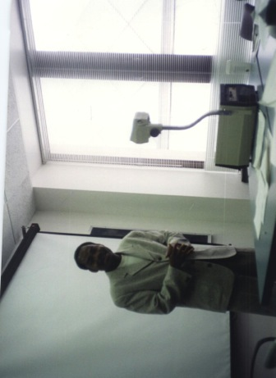
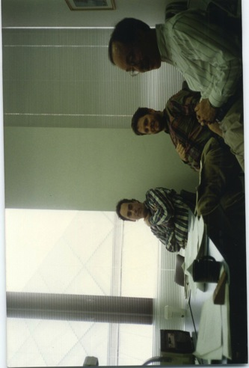
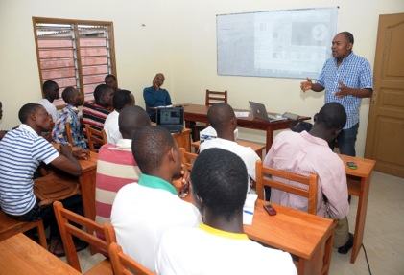
Pursued PhD at Northwestern University and taught at Yale, NYU and Princeton, and founded the Institute for Empirical Research in Political Economy (IERPE) and the African School of Economics (ASE).
PhD. Defense at Northwestern University

Slide 19
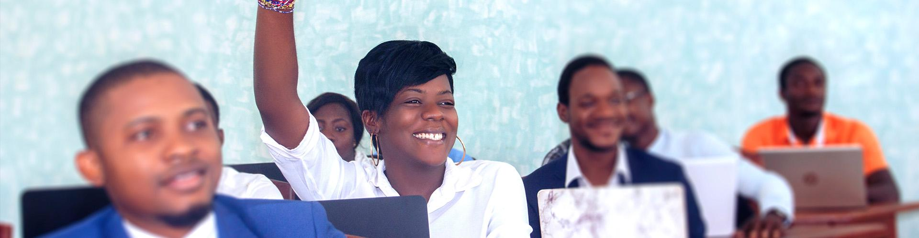
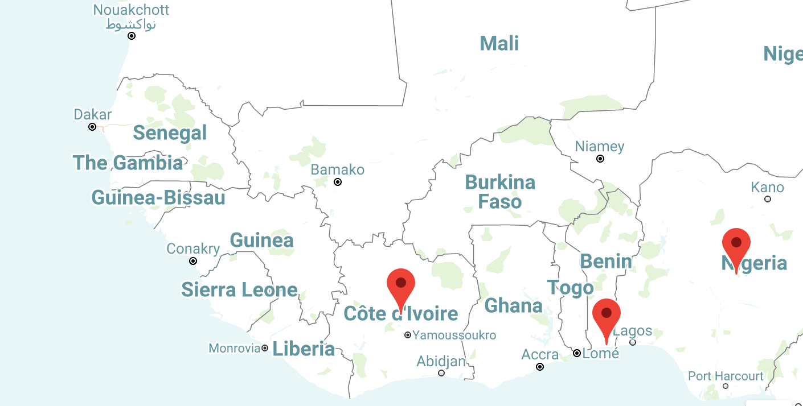

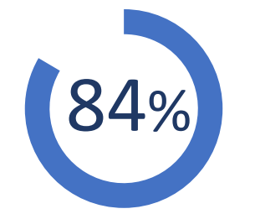
Developed the ASE into an institution that promotes economic research, innovation in public policy and nurtures world-class social scientists and business in Africa.
ASE’s first campus at Cotonou, Benin
24 countries represented
Graduate Placement Rate (First Two Cohorts)

Slide 20
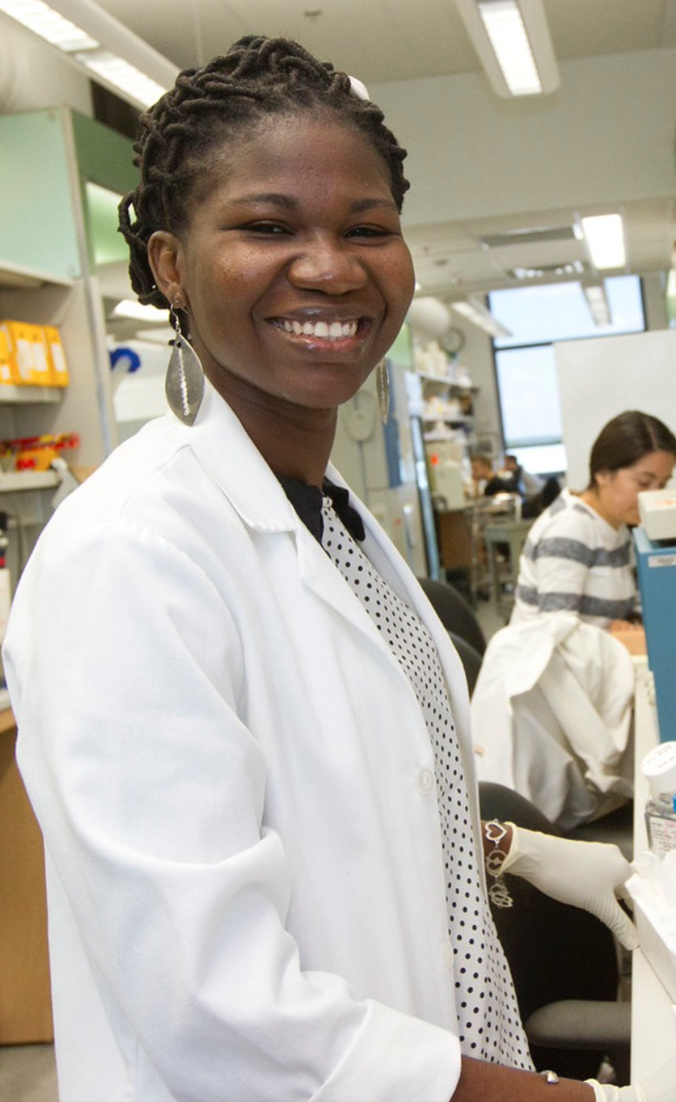
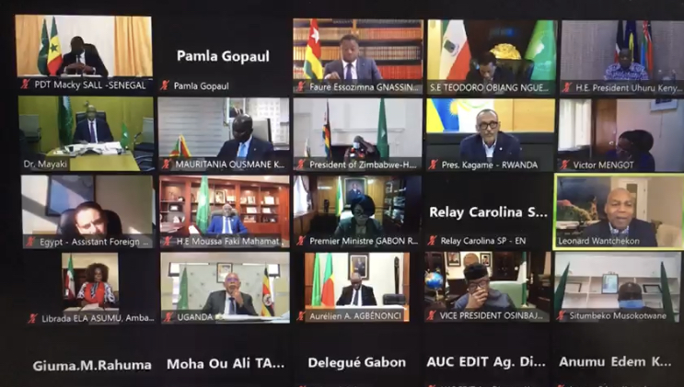
Leads Pan-African efforts to integrate science, innovation and entrepreneurship across the region to accelerate development outcomes.
Addressed the AU Heads of State on Pan-African Policy Engagement
Founded the Pan African Scientific Research Council (PARSC)- A Network of ~550 Scientists

Slide 21
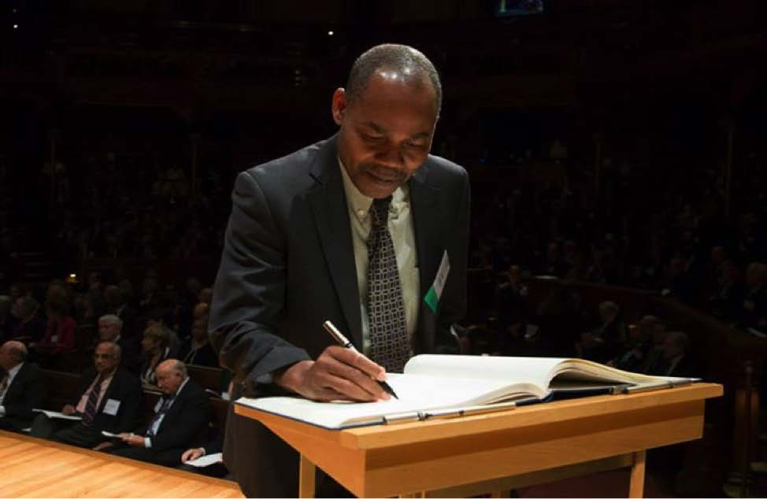
Became a Fellow of the American Academy of Arts and Sciences in 2013 and a Fellow of the Econometric Society in 2018.
Fellowship Ceremony at the American Academy of Arts and Sciences (2013)

Slide 22
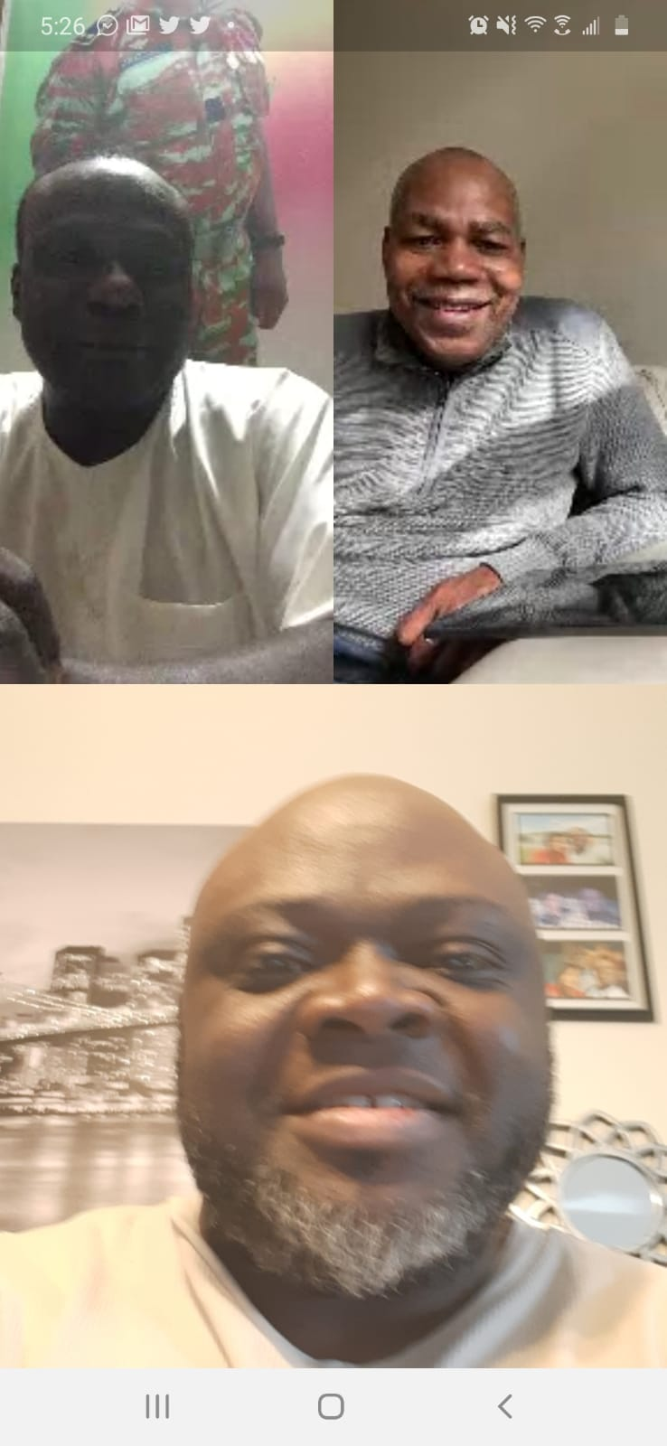
In 2020, thanks to Codjo (below), had the chance to speak to one of the two officers who led my 1985 arrest, conducted the interrogation and the rest….
“Truth and Reconciliation…”

Slide 23
Questions?

